Slide 1
Online Pharmacy Using Singleton
Submitted by:
20MIS0085 – Akash PS
20MIS0087 – Siddharth Kumar
20MIS0123 – Aditya jha

Slide 2

Project analysis slide 2
ABSTRACT
This project aims to tackle the design problems that may arise during the development of Online Pharmacy Application. We intend to dive into the details of what problems may arise during the design phase of this system and how and what design patterns can be used to provide an optimal solution.
The entire development process associated with a generic application like online pharmacy requires use of multiple call requests in as to achieve the overall functionality of the system. Now, when we start to build the system we come across design issues like coupling, cohesion, inheritance etc.
Therefore in this project we will be mapping the construction of the online pharmacy with suitable design patterns in as to overcome this design and implementation issues.

Slide 3

Project analysis slide 2
Problem Statement
Pharmacy Management System may need to perform many different numbers of operations such as adding a new item of medicine in the Pharmacy Database, to display the entire available list of medicines in the database, any user specific query to display any particular record from the database based on the requirements for any given situation, to delete one or multiple medicinal items from the database in case of non-availability of the medicine or if it is out of stock, etc.,
Multiple instantiations of the same class cause memory wastage for the cause of creating new object every time when you actually do not need a new one.
So, there is a need of a Pharmacy Management System which is designed to restrict the instantiation of class for performing same type of operations to the least number of instances or it would be good to have only one instance.
This one instance should be available to all the clients. By doing this, it should improve the way the memory is handled and with memory being used properly, better performance will be reached.

Slide 4
Project analysis slide 2
Why Singleton for Online Pharmacy Management System?
It is required for the given scenario that we keep a single database for the pharmacy since if any medicines are taken from the required warehouse(database) then the database is to be updated.
From the development perspective we cannot have multiple instances for the same database since the availability of the medicines is to be synchronized across all the people that want to access the database.

Slide 5
Project analysis slide 2
Singleton
Intent:
Singleton is a creational design pattern that lets you ensure that a class has only one instance, while providing a global access point to this instance.
Motivation:
For the given scenario we want to solve major problem The database shall only have one instance so that everyone who wants to excess it can share this information amongst themselves and update the medicines when are either taken from the warehouse(database) or supplied to the warehouse(database).
With the use of singleton pattern the warehouse(database) will only have one unique instance shared among all users and we could update the details for that same instance

Slide 6
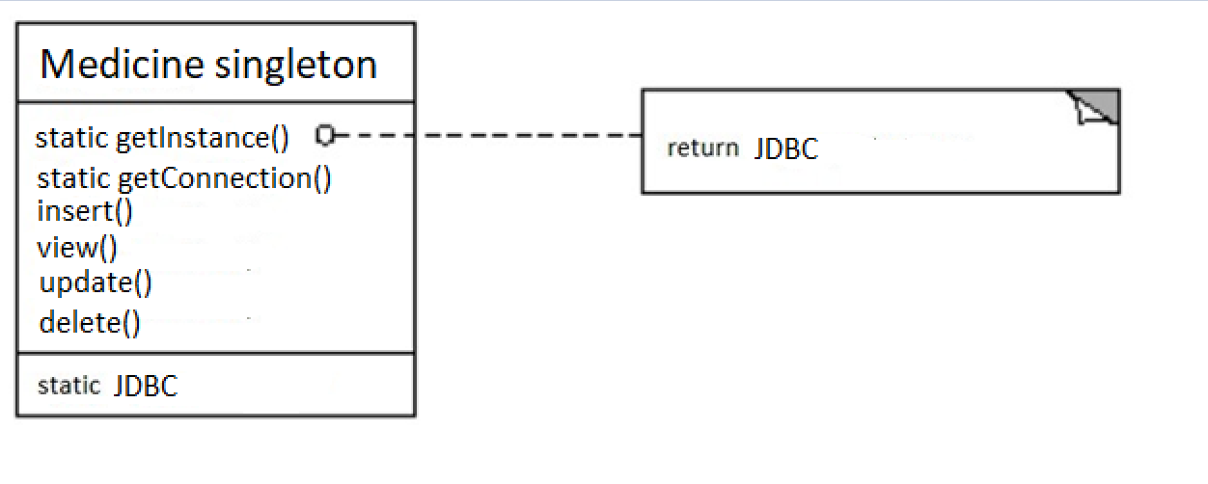
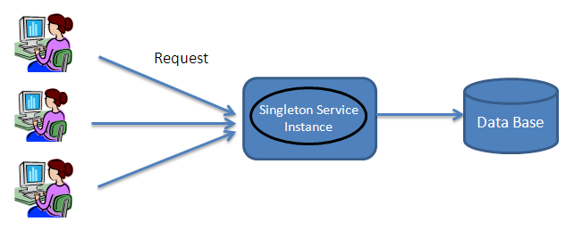
Project analysis slide 2
System Architecture

Slide 7
Project analysis slide 2
Applicability
Use the Singleton pattern when:
there must be exactly one instance of a class, and it must be accessible from a well-known access point available to all clients; for example, a single database object shared by different parts of the program.
The sole instance should be extensible by sub classing, and clients should be able to use an extended instance without modifying their code.
You need stricter control over global variables.

Slide 8
Project analysis slide 2
How to implement?
Implementation:
All implementations of the Singleton have these two steps in common:
Make the default constructor private, to prevent other objects from using the new operator with the Singleton class.
Create a static creation method that acts as a constructor. Under the hood, this method calls the private constructor to create an object and saves it in a static field. All following calls to this method return the cached object.

Slide 9
Project analysis slide 2
Implementation issues
Ensuring a unique instance.
The Singleton pattern makes the sole instance a normal instance of a class, but that class is written so that only one instance can ever be created.
Subclassing the Singleton class.
The main issue is not so much defining the subclass but installing its unique instance so that clients will be able to use it.

Slide 10
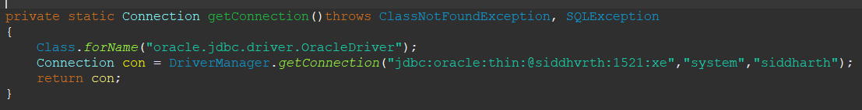
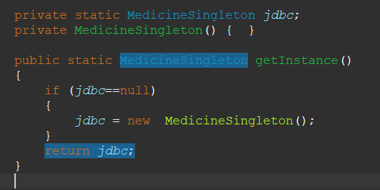
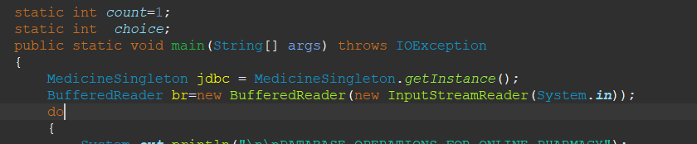
Project analysis slide 2
Code Snippet
Static getInstance Method()
Single Instance of MedicineSingleton jdbc
Instantiating the single instance

Slide 11
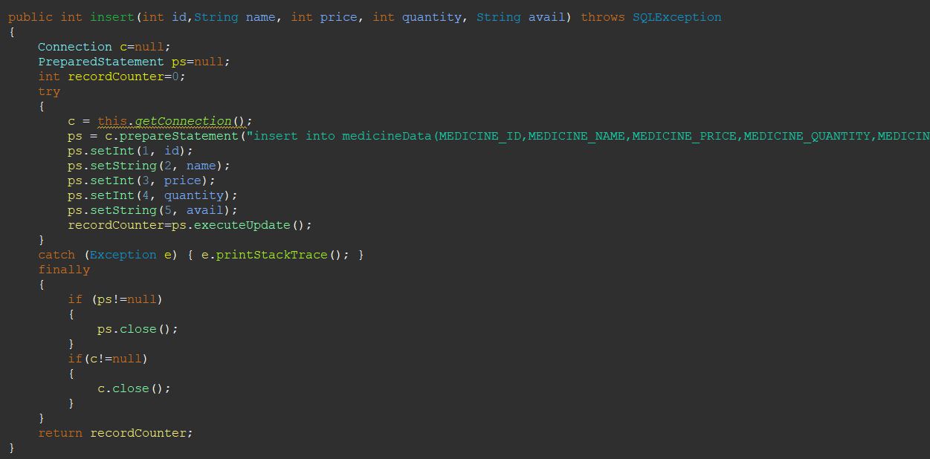
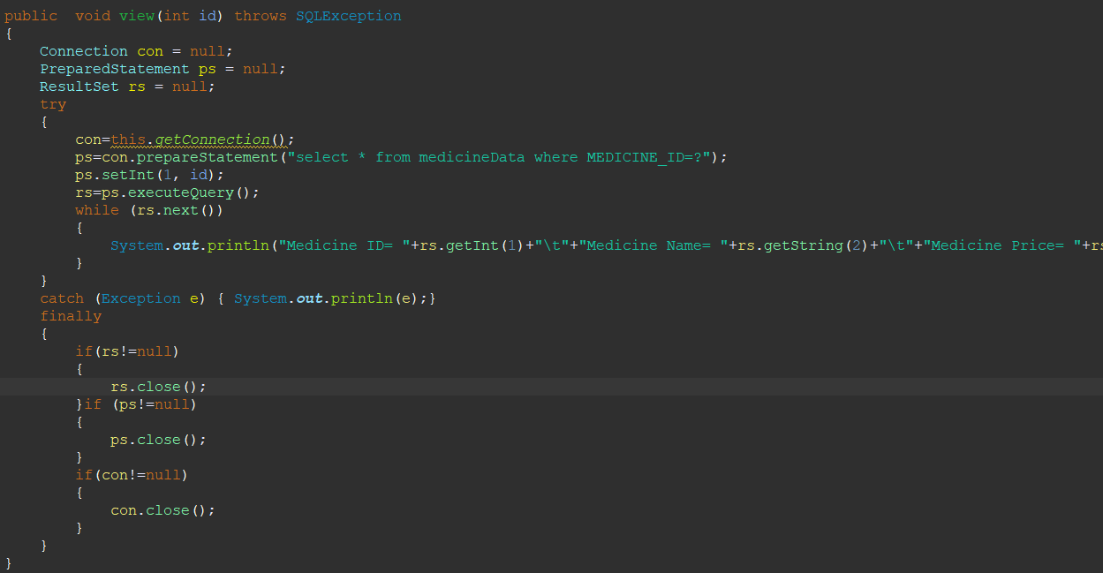

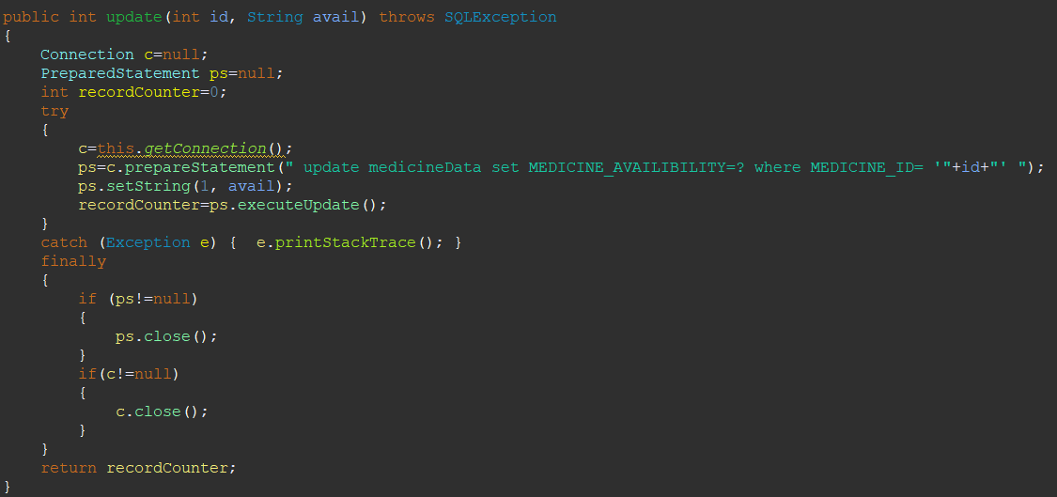
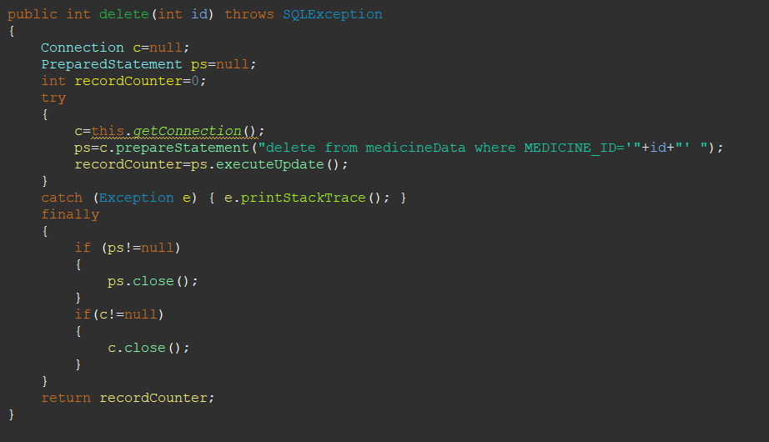
Project analysis slide 2
Code Snippet
Global reference to
the single private Instance

Slide 12
Project analysis slide 2
Results Obtained
A singleton class medicine has been created and a single object was instantiated.
a global access point to the instance was created.
The singleton object is initialized only when it’s requested for the first time.
The medicine records were maintained using a single object.
Since only one object is used, the memory usage is reduced and the performance is enhanced.

Slide 13
Project analysis slide 2
Conclusion
With Singleton pattern, a singleton class Medicine was created and a single object was used throughout the code.
By using this pattern, memory usage was reduced. Singleton prevents creation of multiple objects which occupies space in memory. Since the class controls the instantiation process, the class has the flexibility to change the instantiation process. This enhanced the performance of the system.

Slide 14
Thank You

